Slide 1

Quantum key distribution: bb84 Protocol
Rakesh Kumar A

Slide 2
Outline
Classical Cryptography
One-Time Pad
Classical Key Distribution
Why Quantum Cryptography?
Principles to know
Heisenberg Uncertainty
Photon Polarization
Overview on Quantum Cryptography
Quantum Key Distribution(QKD)
BB84 Protocol
Pros and Cons
Applications
Fun Facts

Slide 3
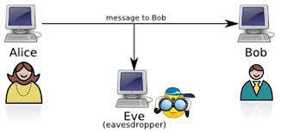
Classical Cryptography
Suppose Alice and Bob wish to communicate in the presence on an eavesdropper Eve.
A provably secure classical scheme exists for this, called the one-time pad.

Slide 4
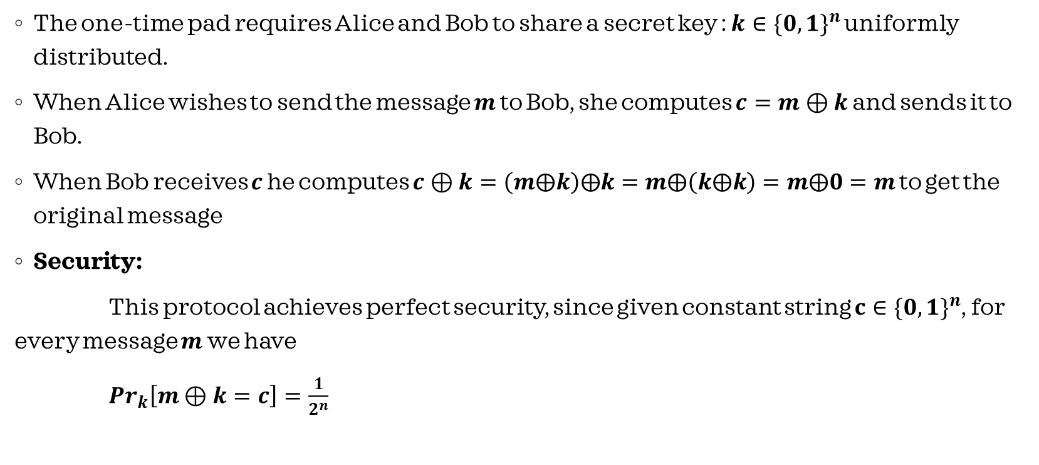
One Time Pad
The one-time pad requires Alice and Bob to share a secret key : $k∈{\{0,1\}}^{n}$ uniformly distributed.
When Alice wishes to send the message $m$ to Bob, she computes $c=m⊕k$ and sends it to Bob.
When Bob receives $c$ he computes $c⊕k=\left(m⨁k\right)⨁k=m⨁\left(k⨁k\right)=m⨁0=m$ to get the original message.
Security:
This protocol achieves perfect security, since given constant string $c∈{\{0,1\}}^{n}$, for every message $m$ we have
${Pr}_{k}\left[m⊕k=c\right]=\frac{1}{2^{n}}$

Slide 5
Classical Key Distribution
Problem : How do Alice and Bob share the secret key between them before sending the message?
Key distribution protocol can be based on any one-way function.
There is no known polynomial-time algorithm to crack one-way function. That is what makes this a “HARD” problem.
For Key distribution, we take help of Public Key cryptography to share secret key.

Slide 6
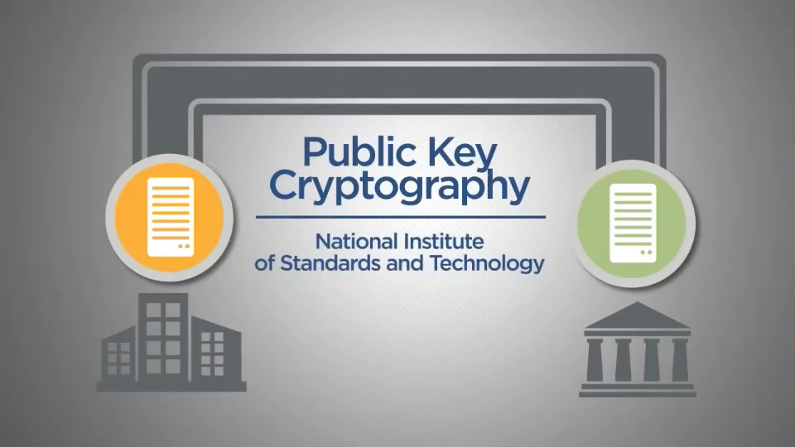
Clip to show Classical Key distribution:

Slide 7
Why Quantum Cryptography?
Classical cryptography is built on mathematical theory which is assumed to be hard to crack.
But using quantum computer and Shor’s algorithm which works on the concept of superposition can solve all existing cryptography models in just no time.
That’s where Quantum cryptography emerges which is not built on mathematics. Instead uses the principles of quantum physics of quantum particles.
As in quantum mechanics, measurement cause disturbance. Can use this disturbance to detect the eavesdroppers on quantum channel.
Problem of distributing the keys in the OTP is overcome in Quantum Key Distribution.
Using quantum effects, we can distribute keys in perfect secrecy!
QC=QKD+OTP

Slide 8
Principles to be known:
Quantum Mechanics depends on 2 major principals:
Heisenberg Uncertainty principle:
States that certain pairs of physical properties are related in such a way that measuring one property prevents the observer from simultaneously knowing the value for other.
Photon Polarization:
Described as having right or left circular polarization etc. Tells that an eavesdropper cannot copy unknown Qubits due to non-cloning algorithm.

Slide 9
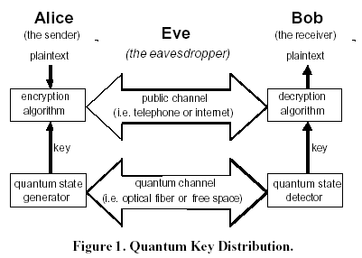
Overview on Quantum Cryptography
Two physically separated parties can create and share random secret keys.
Allows them to verify that the key has not been intercepted.

Slide 10
Quantum Key Distribution(QKD)
A quantum key-distribution protocol is a protocol that uses the quantum mechanical model that enables Alice and Bob to set up a secret key provided they have :
A quantum channel where Eve can read and modify messages
An authenticated classical channel, where Eve can read messages but not modify them
Photos have property called spin which can be directed by passing them by the filters/basis.
Alice uses 4 filters which are sub categories as :
Diagonal Scheme
Rectilinear Scheme

Slide 11
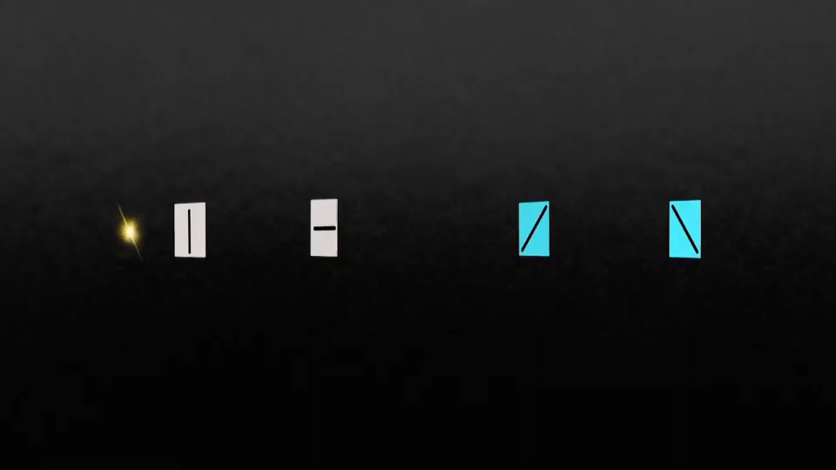
Alice : Clip to show Spin of Photons

Slide 12

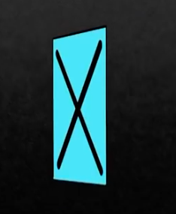
On Other hand, Bob and Eve tries to read the photons using 2 Basis:
Rectilinear Basis
Diagonal Basis
Rectilinear basis Diagonal Basis

Slide 13
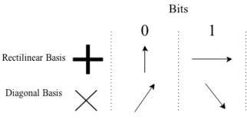
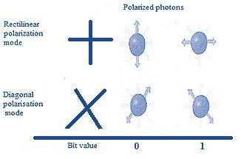
BB84 Protocol
BB84 was the first security protocol implementing QKD.
Key consists of bits that will be transmitted as photons.
Each bit is encoded with random polarization basis.
This protocol is easier to implement in reality but harder to analyze.
Representation of bits :

Slide 14
Procedure
Step 1: Alice transmits a polarized beam in short bursts. The polarization in each burst is randomly modulated to one of four states (horizontal, vertical, left-circular, or right-circular). Transmission takes place on Quantum Channel. This Key is called “Raw Key”.
Step 2: Bob measures photon polarizations in a random sequence of basis (rectilinear or diagonal basis) and makes note of obtained raw key.
Note: Raw Key is not the final key.
Step 3: Bob announces on the public channel what sequence of basis were used.
Step 4: After having a look on basis order of Bob used. Alice also announces on the public channel such that bob will know which basis were correctly chosen.
Step 5: Alice and Bob discard all observations/bits which are not correctly-chosen basis.
Step 6: To check if eavesdropping took place or not, Alice chooses random bits from the key and send it to Bob over public channel.

Slide 15
Procedure
Step 7: Bob cross checks those bits with his bits and if:
all bits are matching then they drop those publicly announced bits and rest of the remaining bits become Key.
Even if there is a single bit change then Alice and Bob will drop the key completely and the procedure is started again. This indicates that some interference has took place with the communication.

Slide 16
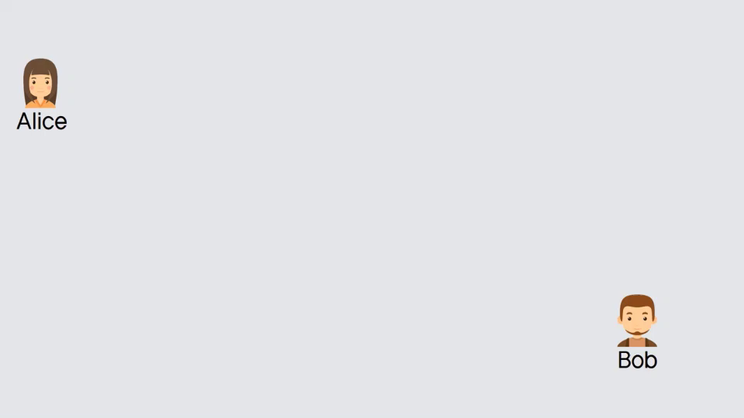
Example

Slide 17
Pros and Cons
Merits:
Nearly Impossible to steal
Detect if someone is listening
Can find if Eve is present or not at the time of key distribution itself. Which mean, messages are only sent when it is confirmed that Eve is not part of channel.
Limitations:
Distance of communication, current limitation is 60 miles ~ 96KM.
Photons can be sabotaged easily.
Not compatible with traditional networks.

Slide 18
Applications
Bank-to-ATM transactions,
Financial information protection
01
Military and Government Communication
02
Ground to Satellite and Satellite-to-Satellite communication.
03

Slide 19
Fun Facts
On 22nd Mar 2021, DRDO successfully tests quantum key distribution tech for secure communication between 2 facilities over 12 KM.
China 14th five-year plan calls for increased investment in a number of emerging sectors, from cryptocurrencies to quantum computing.

Slide 20
REFERENCE
Simple Proof of Security of the BB84 Quantum Key Distribution Protocol Peter W. Shor and John Preskill Phys. Rev. Lett. 85, 441

